Slide 1
3 ELECTROCHEMISTRY
Standard Hydrogen Electrode Advantages and Limitations
Dr.Rani Pavithran
Assistant Professor & Head
Department of Chemistry
College of Engineering Trivandrum

Slide 2
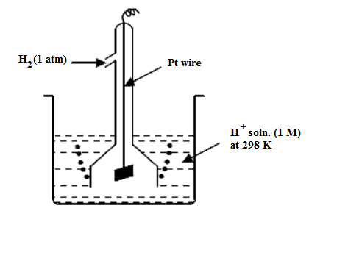
Standard Hydrogen Electrode (SHE) or Normal Hydrogen Electrode (NHE)
Example of gas electrode.
It consists of an inert platinum electrode dipped in 1M H⁺ (HCl) solution, in contact with H₂ gas at 1 atm. pressure at 298 K.
SHE is a standard reference electrode and its potential is taken as zero. The electrode can be represented as Pt/H_{2(g)1atm}/H⁺_{(1M)}

Slide 3
Standard Hydrogen Electrode (SHE)
SHE is a reversible electrode which can act as cathode or anode depending on the potential of the electrode to which it is coupled.
If the potential of the coupled electrode is less than zero (Eg; Zn, Mg, Li etc), reduction reaction takes place in SHE and it acts as cathode as shown below
H⁺ + e⁻ ½ H_{2(g)} (reduction)
When the potential of the coupled electrode is greater than zero eg; Cu; Ag; F₂, oxidation reaction takes place in SHE and it acts as anode:
½ H_{2(g)} H⁺ + e⁻(oxidation)

Slide 4
Standard Hydrogen Electrode (SHE)
Standard hydrogen electrode is the primary reference electrode used for finding single electrode potential of other electrodes.
-ve or +ve values are obtained for standard reduction potential or standard electrode potential (E⁰) depending on whether the half cell acts as anode or cathode with respect to SHE.
For eg; E⁰ of zinc electrode is –ve, -0.76V, since the electrode acts as anode with respect to SHE.

Slide 5
Advantages of SHE
Small potential is developed on the hydrogen electrode, hence it can be taken as zero.
In determining the single electrode potential, using S.H.E. as a reference, the potential of the unknown electrode will be equal to the emf of the cell.

Slide 6
Limitations of SHE
It is not convenient to assemble the apparatus and to prepare ideal platinised platinum plate.
It is difficult to get pure, dry hydrogen gas
The impurities present in H₂ and HCl poison the Pt, and affect the equilibrium at the electrode. The hydrogen electrode will be poisoned by compounds containing Hg; As; S; Fe³⁺; MnO₄ etc.
It cannot be used in solutions containing redox systems.
Difficult to maintain pressure of H₂ gas at 1atm and difficult to maintain the concentration of 1M HCl

